Slide 1

HUMAN TRAFFICKING

Slide 2
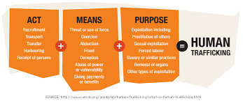
WHAT DOES HUMAN TRAFFICKING MEANS

Slide 3
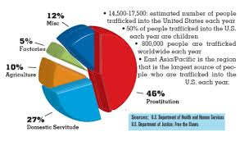
LATEST UPDATE ON HUMAN TRAFFICKING

Slide 4
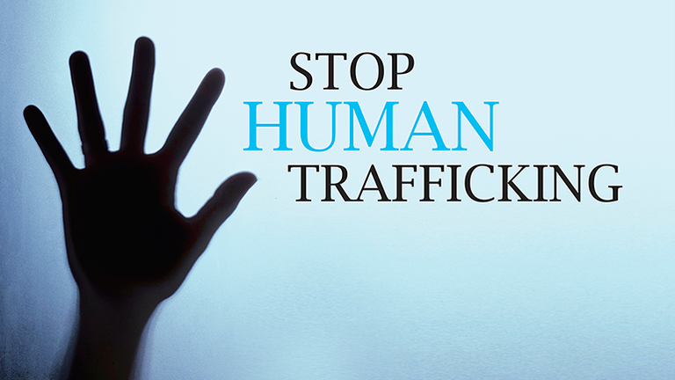
WAYS TO STOP HUMAN TRAFFICKING
Fundraising. Holding a fundraiser and donating the money raised to one of the countless organizations that help to fight human trafficking not only gives money to the cause but also brings awareness to the issue. Most organizations working to fight human trafficking are nonprofit organizations that rely on donations. Holding fundraisers helps maintain these nonprofits.
Volunteer. Volunteering time and effort to an anti-trafficking organization is a great way to contribute to the fight against human trafficking. In addition to helping the organization itself, the more volunteers there are, the greater the outreach can be. For example, Unseen is a nonprofit organization that helps victims of human trafficking by providing specialist care to help them along the road to recovery. There are several volunteer roles with Unseen, ranging in levels of time commitment.

Slide 5
REFERENCE
https://www.pinterest.com/mtvexit/human-trafficking-media/
https://www.state.gov/20-ways-you-can-help-fight-human-trafficking/

